Slide 1
Module 6 – Python Classes, Functions and Modules
Sharon ONeal
sharononeal@email.arizona.edu
520-822-4040

Slide 2

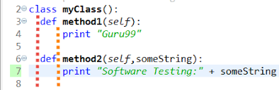
Python Classes
How do you declare a Python Class?
Python classes are a way to group related items into “objects”
Consist of attributes (variables) and methods (functions)
Classes allow the programmer to abstract (or hide) information from the user and calling functions / modules
Python has built in objects that can be used by the programmer

Slide 3
Chapter 9 – In Class Activities
9.1 Classes: Introduction
9.2 Classes: Grouping Data
In programming, an object is a grouping of data (variables) and operations that can be performed on that data (functions or methods).
What is abstraction?
Abstraction is a concept that allows us to hide the complexity of a system from the user. In Python, we can use abstraction to hide the complexity of a class from the user.
What is information hiding or encapsulation?
When a user interacts with an object at a high level, allowing lower-level internal details to remain hidden.
SFWE 101 | classes

Slide 4
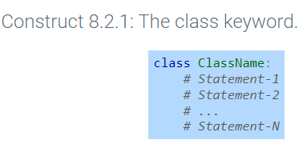
Chapter 9 – In Class Activities
9.1 Classes: Introduction
9.2 Classes: Grouping Data
Define an abstract data type.
An abstract data type (ADT) is a mathematical model for data structures. It is a way of specifying the behavior of a data structure without specifying its implementation. This allows you to focus on the design of the data structure without worrying about how it is implemented.
In short, The abstract data type is special kind of data type, whose behavior is defined by a set of values and set of operations (class: a blueprint for creating objects. ).
Defining a class in Python
SFWE 101 | classes

Slide 5
Chapter 9 – In Class Activities
9.2 Classes: Grouping Data
Classes contain attributes.
What is an attribute?
A class defines a new type that can group data and functions to form an object. The object maintains a set of attributes that determines the data and behavior of the class.
In Python, attributes are variables that are associated with an object. They can be accessed using the dot notation. But Why?
To give a default value
What does it mean to instantiate a class?
An instantiation operation is performed by "calling" the class, more specifically, it uses the blueprint(class) to create an object(instance).
How do you instantiate a class?
class Car:
pass
my_car = Car() #my_car is the name of the object
SFWE 101 | classes

Slide 6
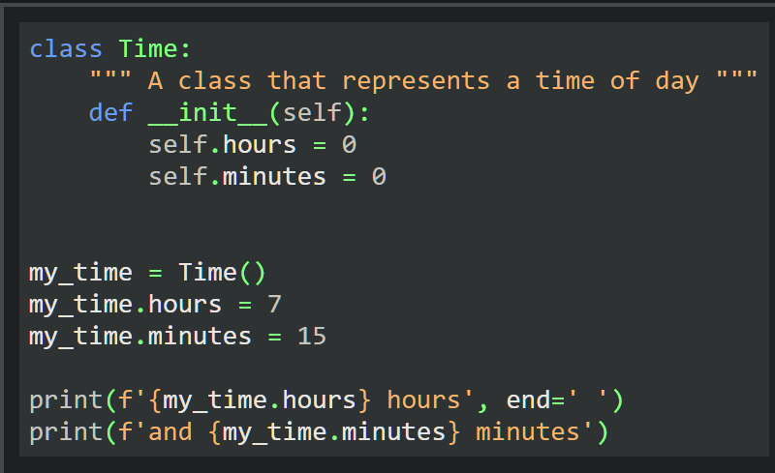
Chapter 9 – In Class Activities
9.2 Classes: Grouping Data
What is a method?
A function defined within a class.
What is a constructor? What does it do?
A constructor in Python is a special method that is called when an object is created. It is used to initialize the object's state.
The __init__ method
SFWE 101 | classes

Slide 7
Chapter 9 – In Class Activities
9.2 Classes: Grouping Data
What is an attribute reference operator?
Attributes can be accessed using the attribute reference operator "."
What is another term for a reference operator?
member operator or dot notation
Talk thru Figure 9.2.3
Complete Challenge Activity 9.2.2 (solve at your desk and 1 person share)
Complete Challenge Activity 9.2.3 (solve at your desk and 1 person share)
SFWE 101 | classes

Slide 8
Chapter 9 – In Class Activities
9.3 Instance Methods
What is an instance method?
A function defined within a class is known as an instance method.
How is an instance method invoked or called?
An instance method is invoked or called in Python by using the dot notation.
instance.method(args)
What is a special method?
A special method is a method that is prefixed with a double underscore (__), Special methods are used by the Python interpreter to perform special operations, such as calling the constructor or destructor of an object.
E.g., __init__ is also a method of the Time class; however, __init__ is a special method name
SFWE 101 | classes

Slide 9
Chapter 9 – In Class Activities
9.3 Instance Methods
What does this method do? Does it have to be referred to this way?
__init__
Are there other special methods?
__str__ : This method is called when an object is converted to a string.
__len__: This method is called when the length of an object is needed.
__eq__: This method is called when defining if two objects are equal.
You can find other “special methods” at the following site: Special Methods — Python Like You Mean It
Challenge activity 9.3.2
SFWE 101 | classes

Slide 10
Chapter 9 – In Class Activities
9.4 Class and instance object types
What is a class object?
A program with user-defined classes contains two additional types of objects: class objects and instance objects.
A class object acts as a blueprint that creates instance objects.
What is the scope of a class attribute? Who is it shared with?
A class attribute is shared among all instances of that class. Class attributes are defined within the scope of a class.
Any method or function in the class can access the class attribute.
What is the scope of an instance attribute?
An instance attribute can be unique to each instance.
Challenge Activity 8.4.1
SFWE 101 | classes

Slide 11
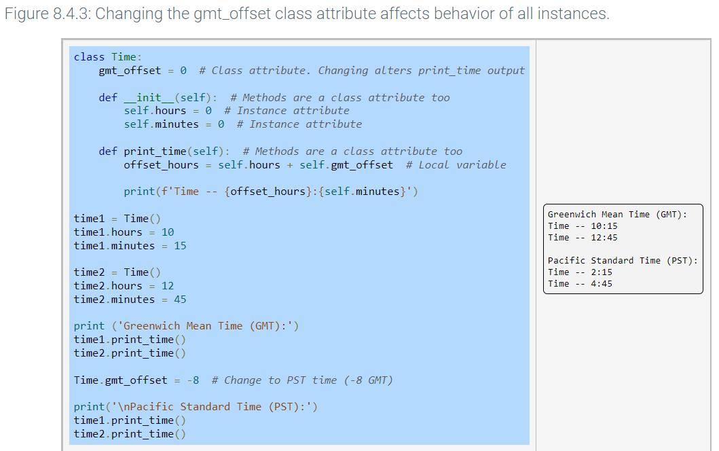
Chapter 9 – In Class Activities
9.4 Class and instance object types
SFWE 101 | classes

Slide 12
Chapter 9 – In Class Activities
9.6 Class Constructors
What is a class constructor?
A class constructor in Python is a special method that is called when an object of that class is created. It is used to initialize the object's state.
How do you create a class constructor?
def __init__(self, *args, **kwargs):
#def __init__(self, start_time, end_time, distance):
# do something with args and kwargs
self is a reference to the newly created object
*args is a tuple of positional arguments
**kwargs is a dictionary of keyword arguments
SFWE 101 | classes

Slide 13
Chapter 9 – In Class Activities
9.7 Class interfaces
9.8 Class Customization
What is a class interface?
A class interface consists of the methods that a programmer calls to interact (create, modify, or access) with a class instance.
A class interface in Python is a set of methods that a class must implement.
Good practice is to prepend an underscore to methods only used internally by a class. _diff = begin – end (It’s just a convention)
What is class customization?
Class customization is the process of modifying the behavior of a class. This can be done by adding new methods, overriding existing methods, or changing the behavior of existing methods.
SFWE 101 | classes

Slide 14
Chapter 9 – In Class Activities
9.7 Class interfaces
9.8 Class Customization
What is operator overloading? When might we want to do this?
Class customization can redefine the functionality of built-in operators like <, >=, +, -, and * when used with class instances, a technique known as operator overloading.
Term rich comparison methods
__lt__(self, other)
__le__(self, other)
__gt__(self, other)
__ge__(self, other)
__eq__(self, other)
__ne__(self, other)
SFWE 101 | classes

Slide 15
Chapter 9 – In Class Activities
Time to code!!!!
In your table groups, work on the following LABS:
9.10 LAB: Artwork label (classes/constructors)
9.11 LAB: Winning teams (classes)
9.12 LAB: Nutritional information (classes / constructor)
Who will share their solution with the class?????
SFWE 101 | classes

